Slide 1

Customer Shopping Behavior Analysis
Uncovering insights from 3,900 purchases to drive strategic decisions

Slide 2
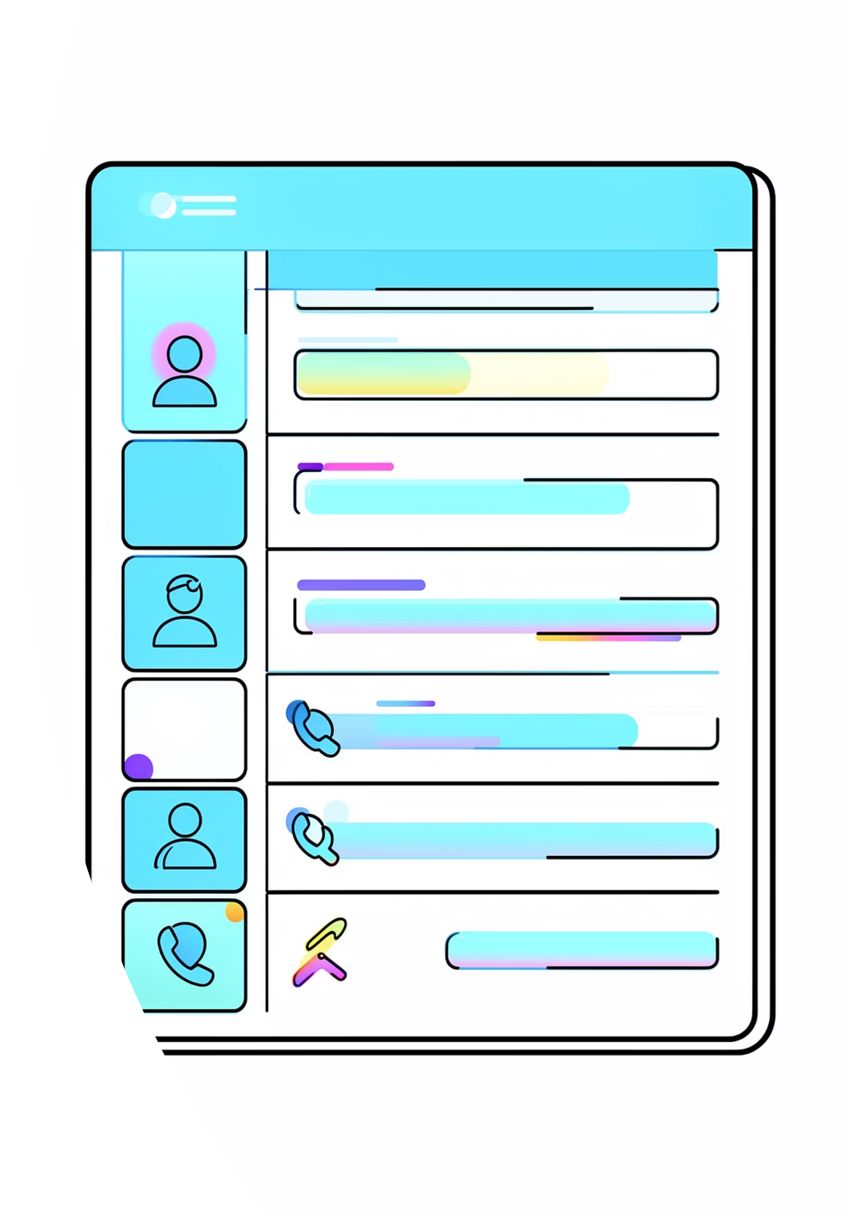
Dataset Overview
3.9K
18
Customer Purchases
Data Fields
Transactional data analyzed
Demographics, purchases, behavior
37
Missing Values
Review ratings imputed

Slide 3
Python Data Preparation
Data Loading
Missing Data
Imported using pandas with df.info() and describe() for initial exploration
37 null values in Review Rating column imputed using median by category
01
02
03
Column Standardization
Feature Engineering
Database Integration
Renamed to snake case for readability
Created age groups and purchase frequency days
Loaded to PostgreSQL for SQL analysis

Slide 4

Revenue by Gender
Male·67.62%
·67.62%
·
Female·32.38%
·32.38%
·
Male customers generated $73,500 in revenue, representing 67.6% of total revenue, while female customers contributed $35,200, or 32.4%. Average transaction value is also slightly higher among male customers at $42.15 versus $38.90 for female customers.
The revenue gap appears to be driven more by higher purchase volume than by a large difference in transaction value, suggesting an opportunity to increase frequency and conversion among female customers through targeted offers, category-specific campaigns, and retention programs.

Slide 5

Top Products by Rating
1
2
3
Gloves
Sandals
Boots
3.86 average rating
3.84 average rating
3.82 average rating
4
5
Hat
Skirt
3.80 average rating
3.78 average rating

Slide 6

Shipping & Subscription Impact
Shipping Type
Subscription Status
Standard: $58.46 avg
Express: $60.48 avg
Non-subscribers: 2,847 customers
Subscribers: 1,053 customers

Slide 7




Discount-Dependent Products
50%
49%
49%
Hat
Sneakers
Coat
Half purchased with discount
High discount dependency
Seasonal discount appeal
48%
47%
Sweater
Pants
Regular discount usage
Discount-driven purchases

Slide 8

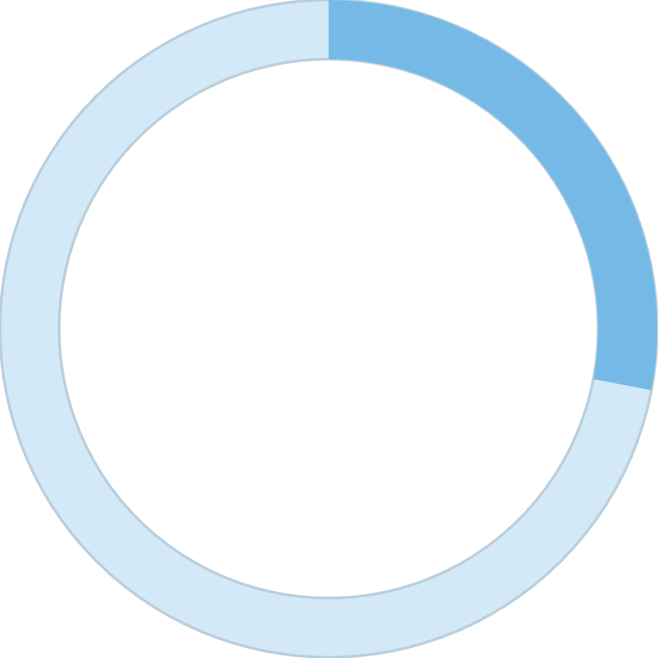

Customer Segmentation
70%
28%
2%
Loyal
Returning
New
2,721 repeat customers
1,096 customers
83 customers

Slide 9
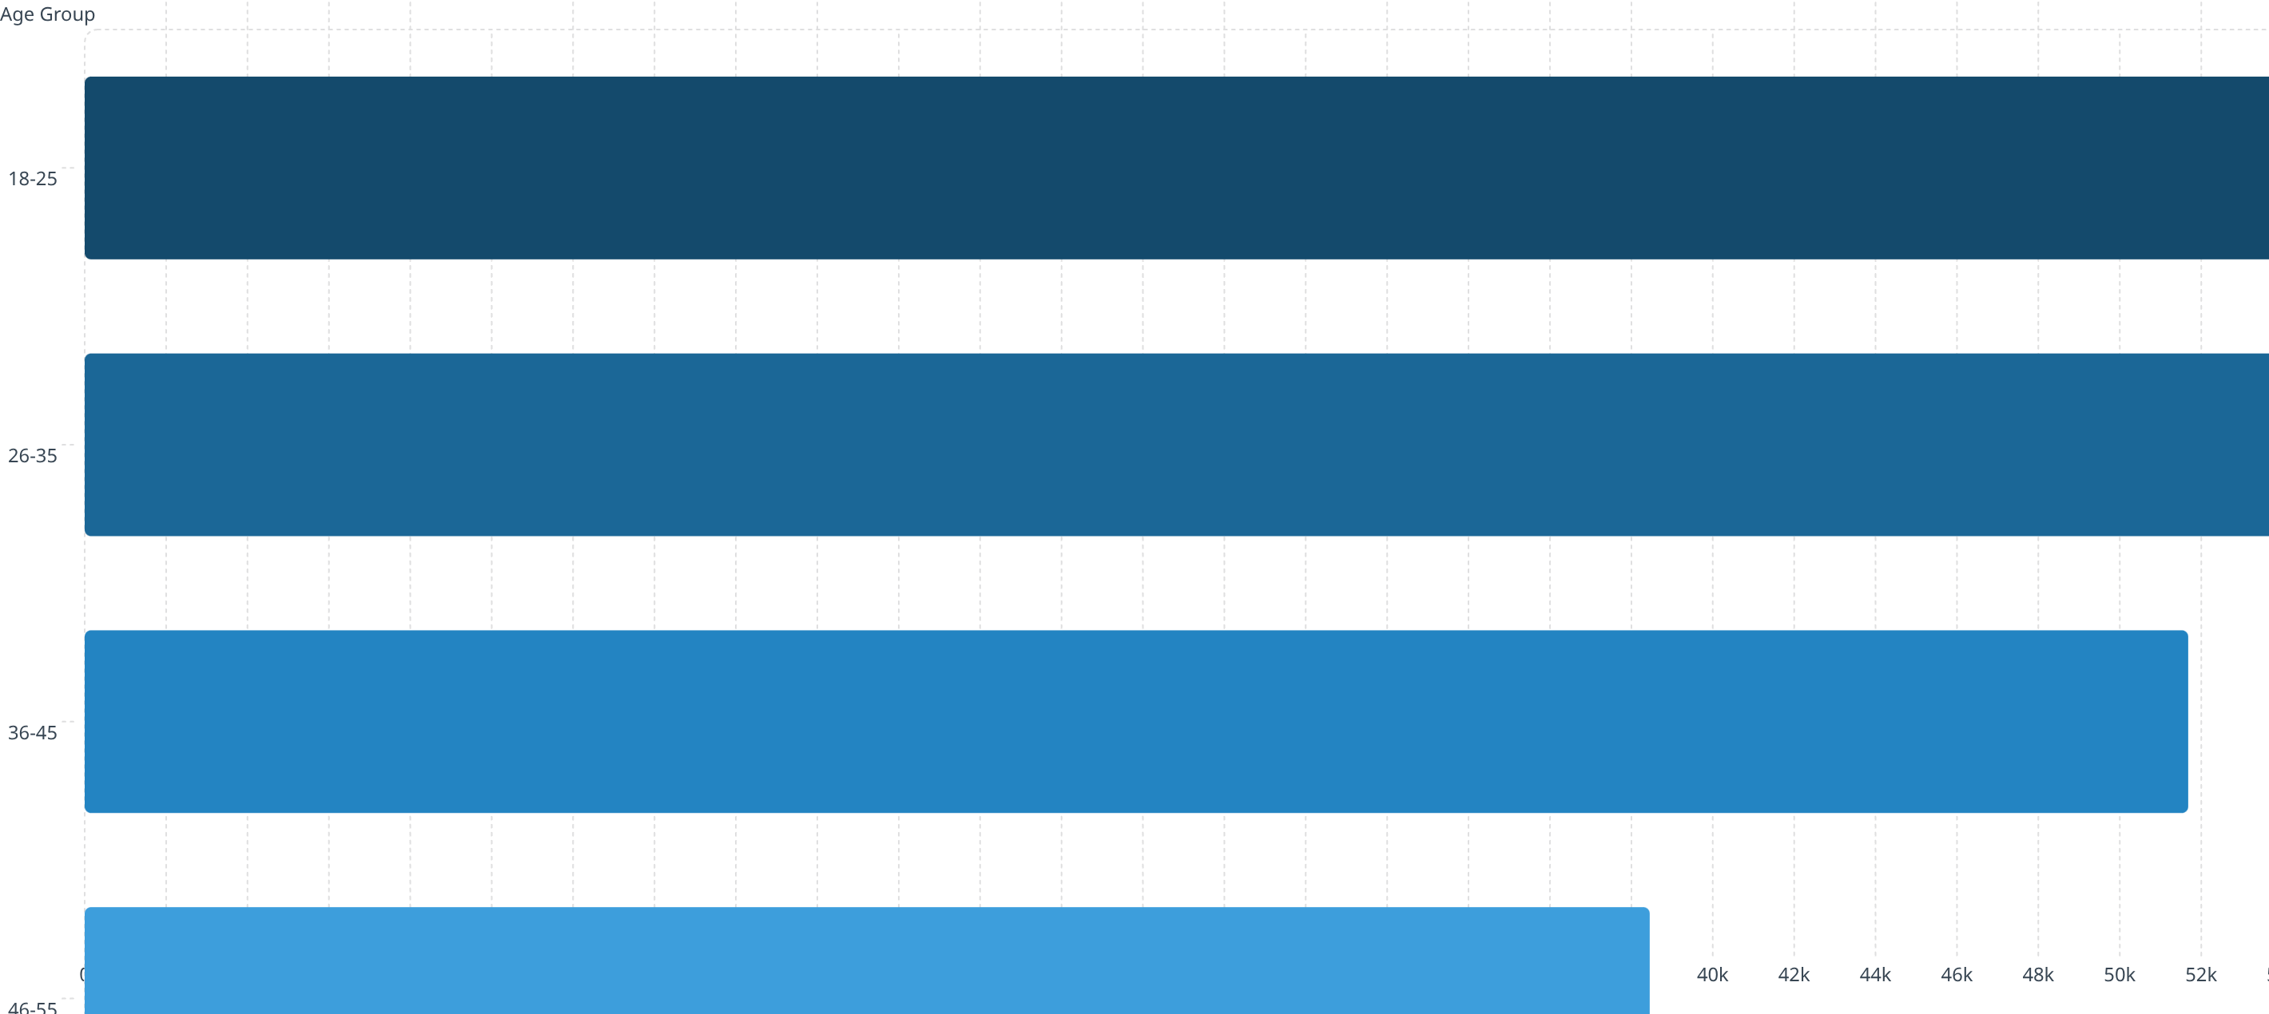
Revenue by Age Group
Young adults ages 18-35 are our revenue engine, generating 51.5% of total sales through frequent repeat purchases. By contrast, customers 55+ shop less often, but they bring real value with larger basket sizes—making them an important growth opportunity.

Slide 10






Strategic Recommendations
Boost Subscriptions
Promote exclusive benefits for subscribers
Customer Loyalty Programs
Reward repeat buyers to move into "Loyal" segment
Review Discount Policy
Balance sales boosts with margin control
Targeted Marketing
Focus on high-revenue age groups and express-shipping users

